Slide 1
Analytical Instrumentation
Prof. Sujit M. Deokar,
Department of Instrumentation Engg.
Vishwakarma Institute of Technology, Pune
Lecture 04 :
Radiation & Matter

Slide 2
Recap
Transmission of Radiation
Dispersion
Diffraction
Reflection & Refraction
Snell’s Law
Polarization of Light
Prism as dispersive device
Monochromatic Slit

Slide 3
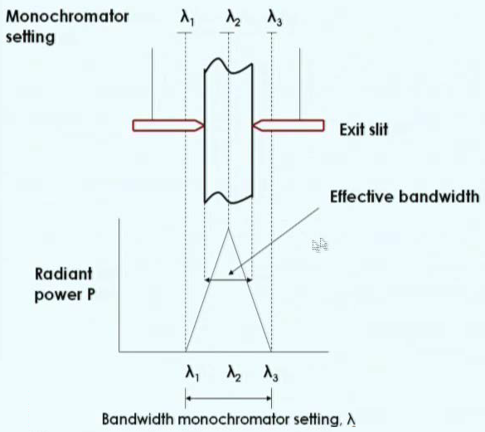
Monochromator Slit
Illumination of the exit slit with the desired wavelength is invariably associated with some unwanted radiation as shown here lambda 1 and lambda 2, which I did not show it there. This is known as bandwidth.

Slide 4
The effective bandwidth is also called as spectral band pass or a spectral slit width. It is half of the bandwidth when the two slit widths are identical. It is very important. Two slit widths should be identical.
When the effective bandwidth is decreased to one half the wavelengths of the three beams, complete resolution can be obtained.

Slide 5
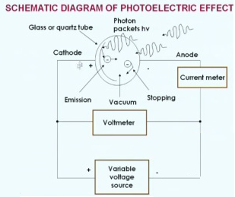
Photoelectric Effect

Slide 6
What is photoelectric effect basically?
When monochromatic light falls on a photocathode, electrons of varying kinetic energies are emitted from its surface and fly over to the anode in the phototube as long as the voltage V is applied between the anode and cathode is positive. It produces a current I in the circuit.
when the voltage across the phototube is adjusted in such a way that the anode is negative and cathode becomes positive, the electrons are repelled by the anode and photocurrent decreases.
The photoelectric effect current therefore is measured as a function of the applied voltage, V 0 at which photoelectric current reaches zero multiplied by electronic charges (1.6x10⁻¹⁹ C) this gives the kinetic energy of the most energetic electrons in joules.

Slide 7

When maximum kinetic energy for various coatings are plotted as a function of the radiation frequency, we get a straight line response with a slope h and an intercept.
The plots can be described by the equation,
The work function, -w is a characteristic of the surface material on which the cathode is coated. This represents the minimum energy of binding the electron to the metal atom. It is also equal to the energy of the electromagnetic radiation, that is, photon energy required to eject a photo electron from the irradiated surface.

